Slide 1
Module 12: Modeling Slowly Changing Dimensions
Analytics: Server Architect (Siebel 7.7)
Notes:
Time: Lecture: approximately 25 minutes; labs: see Lab Guide for timings.
Intent: This module discusses how to implement slowly changing dimensions.
Flow: Slowly changing dimensions are defined, then techniques for handling them are discussed, and finally implementation steps are explained in the context of an ABC example.
Key Terms:
Slowly changing dimensions (SCDs)
Type One
Type Two
Type Three
12

Slide 2

Module Objectives
After completing this module you will be able to:
  Describe techniques to address slowly changing dimensions
  Implement a solution to model slowly changing dimensions
Why you need to know:
  Understanding techniques to deal with slowly changing dimensions allows you to design and model for your business needs
Notes:
Each objective and “why you need to know” should be stated aloud.

Slide 3
Slowly Changing Dimensions (SCDs)
Refer to dimensions whose attribute values vary over time
  Example: The sales representative assigned to a customer may change over time
Alley-Cats is transferred from Linda to Kathy
Linda Rivero’s Customers
Clifton Lunch
Club 427
Alley-Cats
Kathy Lobo’s Customers
Royal Barbecue
Tong’s Wok
Alley-Cats
Notes:
This slide defines slowly changing dimensions (SCDs).
12

Slide 4
Challenge
Provide capabilities to analyze data “as is,” “as was,” or both
When calculating total sales, should the dollars for Alley-Cats be reported for Linda or Kathy, or split between them?
Linda Rivero’s Customers
Clifton Lunch
Club 427
Alley-Cats
Kathy Lobo’s Customers
Royal Barbecue
Tong’s Wok
Alley-Cats
Notes:
This slide identifies the business challenge. Organizations need the ability to analyze data that changes over time. In this example, the sale rep for an account has changed. When calculating total sales for the account, should the revenue be reported for Linda Rivero, Kathy Lobo, or both sales reps?

Slide 5
Techniques
Siebel Analytics can model any method of handling SCDs
There are three common methods:
  Type One: overwriting history
  Type Two: preserving history
  Type Three: preserving a version of history
Notes:
This is a structuring slide identifying the different ways that SCDs can be modeled using Siebel Analytics. Provide a high-level overview here. The details are explained on subsequent slides.
12

Slide 6
Type One: Overwriting History
One record is stored with the new data
  New value overwrites the old value
  Single column stores the attribute value
  Old value is lost
Customer | Sales Representative
Clifton Lunch | Linda Rivero
Club 427 | Linda Rivero
Alley-Cats | Linda Rivero
Royal Barbecue | Kathy Lobo
Tong’s Wok | Kathy Lobo
Customer | Sales Representative
Clifton Lunch | Linda Rivero
Club 427 | Linda Rivero
Alley-Cats | Kathy Lobo
Royal Barbecue | Kathy Lobo
Tong’s Wok | Kathy Lobo
becomes
Notes:
With a Type One SCD a new value overwrites the old value. In the example, after the change, there would be no way to know that Linda was the former sales representative who was assigned to the Alley-Cats customer.

Slide 7
Type Two: Preserving History
Multiple records are stored
  Old record contains old value in a single column
  New record contains new value in a single column
  Common to using timestamps to differentiate the records
    All prior versions are saved
Customer | Sales Representative | Effective Start | Effective End
Clifton Lunch | Linda Rivero | 19980101 | 30000101
Club 427 | Linda Rivero | 19980101 | 30000101
Alley-Cats | Linda Rivero | 19980101 | 19990131
Royal Barbecue | Kathy Lobo | 19980101 | 30000101
Tong’s Wok | Kathy Lobo | 19980101 | 30000101
Alley-Cats | Kathy Lobo | 19990201 | 30000101
Old
End date adjusted
New
New record added
Notes:
Using the Type Two method, multiple records are stored. It is common to use time stamps to differentiate the records. Here the fictitious end date of year 3000 month 01 and day 01 is used as an ending date. Some systems might use NULLs or other techniques to differentiate the records from each other and identify which is the current record.
12

Slide 8
Type Three: Preserving a Version of History
One record is stored with the old and new values
  Two columns store the attribute values
  Old value is moved from current to prior column
    Only one prior version is saved
  New value overwrites current column
Customer | Current Sales Representative | Prior Sales Representative
Clifton Lunch | Linda Rivero | NULL
Club 427 | Linda Rivero | NULL
Alley-Cats | Linda Rivero | NULL
Royal Barbecue | Kathy Lobo | NULL
Tong’s Wok | Kathy Lobo | NULL
becomes
Customer | Current Sales Representative | Prior Sales Representative
Clifton Lunch | Linda Rivero | NULL
Club 427 | Linda Rivero | NULL
Alley-Cats | Kathy Lobo | Linda Rivero
Royal Barbecue | Kathy Lobo | NULL
Tong’s Wok | Kathy Lobo | NULL
Notes:
Using the Type Three method, one record is stored with both the old and new values. In this example, values for each sales rep are stored in different columns.

Slide 9
Alternative to Type Two (Preserving History)
Add a new record at the time of the attribute change and introduce a new key value
  New key of 4555 is introduced that maps to customer 123
  1011 maps to Linda; 4555 maps to Kathy
  Sales are recorded using the correct key value and clearly map to Linda or Kathy
Customer Key | Customer Name | Customer ID | Sales Representative
1011 | Alley-Cats | 123 | Linda Rivero
4555 | Alley-Cats | 123 | Kathy Lobo
Customer Key | Period Key | Product Key | Dollars
1011 | 19980202 | 100 | 1000
1011 | 19980505 | 100 | 1000
4555 | 19990303 | 101 | 2000
4555 | 19990404 | 101 | 2000
4555 | 19990505 | 200 | 100
Sales for Linda
Sales for Kathy
Notes:
This is the technique used in the Siebel Relationship Management Warehouse.
12

Slide 10
Considerations
Which technique to use depends on your business requirements
  Type One does not store history
  Type Two stores all versions of history
  Type Three stores only one version of history
Columns and processing must be added to your source system to track the changes and populate the version information
Notes:
You could also use other combinations of techniques. For example, you could maintain the current customer information in the “regular” customer table and store history information in a separate table by modeling them as partitions.

Slide 11
ABC Example
Enhance ABC’s model to incorporate a slowly changing customer dimension to account for changing sales representatives using the Type Two method
Customer | Sales Representative | Effective Start | Effective End
Clifton Lunch | Linda Rivero | 19980101 | 30000101
Club 427 | Linda Rivero | 19980101 | 30000101
Alley-Cats | Linda Rivero | 19980101 | 19990131
Royal Barbecue | Kathy Lobo | 19980101 | 30000101
Tong’s Wok | Kathy Lobo | 19980101 | 30000101
Alley-Cats | Kathy Lobo | 19990201 | 30000101
Notes:
In the ABC example, the Type Two method is used to preserve history.
12

Slide 12
Implementation Steps
0/4
Create the Physical layer
Create the Business Model and Mapping layer
Create the Presentation layer
Test the results
Notes:
This is a structuring slide. Do not teach the steps or concepts here because the following slides cover them in detail. Provide a high-level description of what will be discussed.

Slide 13
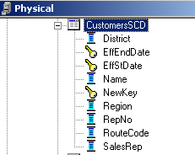
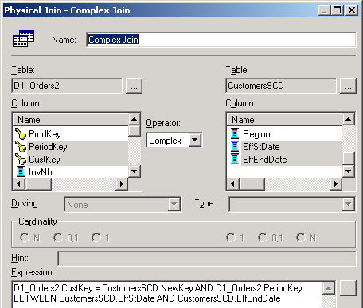
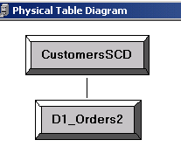
1. Create the Physical Layer
1/4
Import the source that has Type Two physical columns
Create a physical join that includes effective dates
Type Two date columns
Includes clause to match to the correct customer record based on the order date
Notes:
Import the tables the standard way. Notice that the physical join has an additional join (making it a complex join) to match the correct entry in the customer table with the correct entry in the orders table. This is necessary since there may be more than one customer record.
12

Slide 14
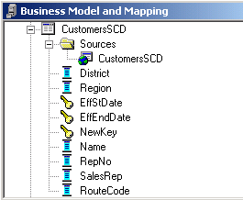
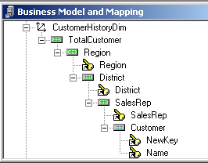
2. Create the Business Model and Mapping Layer
2/4
Create the logical dimension table and corresponding dimensional hierarchy as usual
Notes:
The point here is that you have to repeat all the work you did initially. You can duplicate the original dimension and then modify it accordingly. To duplicate the dimension, right-click CustomerDim and select Duplicate. There are trade-offs to doing this versus creating a new dimension from scratch. For example, you may have to delete as many logical columns in the new dimension as you would have to create.

Slide 15
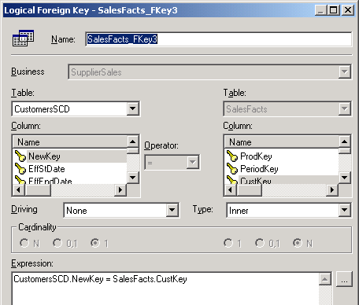
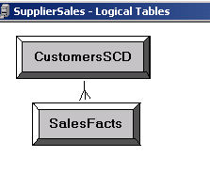
2. Create the Business Model and Mapping Layer Continued
2/4
Model the logical relationship
  No need to add effective dates clause
Notes:
The physical join contains the effective dates and they do not need to be repeated here.
12

Slide 16
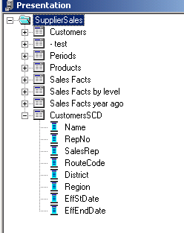
3. Create the Presentation Layer
3/4
Expose data columns as usual
  No need to expose effective dates except for testing purposes
Can coexist with non-SCD customer dimension
Notes:
As mentioned previously, you can have two different customer tables visible to users if you wish or combine different sources into one logical table. There are many possibilities based on the business needs and user sophistication.

Slide 17
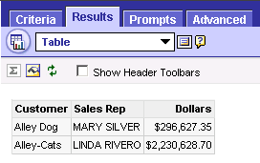
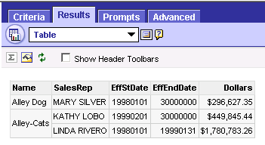
4. Test the Results
4/4
Verify that facts are appearing as expected when attributes change
Results without SCD
Results using SCD:
Sales are allocated between two sales reps assigned to the Alley-Cats customer
Notes:
You can also inspect the query log file.
12

Slide 18
Summary
This module showed you how to:
  Describe techniques to address slowly changing dimensions
  Implement a solution to model slowly changing dimensions
Notes:
Review Questions:
Question: The Siebel Analytics Server can only support Type Two SCDs. True or false?
Answer: False.

Slide 19
Lab
In the lab you will:
  Implement a slowly changing dimension
Notes:
Labs and Troubleshooting:
See Lab Guide for details.
Lab 12-1: During the lab the students create the ABCEXTEND ODBC data source which points to the SupplierExtend database. From this point forward this database is used instead of the original supplier2 database.
Lab 12-2: The students create the dimension hierarchy with limited guidance since they have done so many times before in the labs. Students are given the option to create the CustomerHistoryDim dimension from scratch or to duplicate CustomerDim and modify as necessary. Be sure to be available to help answer questions.
Solution files are available if needed. Also note, the CustomersSCD is not used in any subsequent labs.
12

